Slide 1

Geospatial Logistics Analytics for Delivery Demand and Location Clustering Using Spatial Data Mining and Association Pattern Discovery
CSA1613-DATA WAREHOUSING AND DATA MINING
GUIDED BY: Dr.S.RENUGA
Presented by:-

Slide 2


Abstract
Efficient last-mile delivery depends on knowing where customers order, when they order, and what they order together. This project, Geospatial Logistics Analytics for Delivery Demand and Location Clustering Using Spatial Data Mining and Association Pattern Discovery, applies spatial data mining to delivery order logs and GPS traces to uncover these hidden patterns. After cleaning and geocoding the data and converting coordinates to a metric projection, delivery locations are grouped into demand zones using K-Means and into irregular hotspots using DBSCAN. Getis-Ord Gi* hotspot analysis tests whether high-demand areas are statistically significant, and cluster quality is checked with the silhouette score, the Davies-Bouldin index and elbow analysis. Association rule mining with the Apriori and FP-Growth algorithms then links zones, time slots and item categories, with rules judged by support, confidence and lift. Together, the clusters and rules show where demand concentrates and what and when customers order. This supports decisions on hub placement, route planning, rider allocation and zone-wise stocking.

Slide 3
Introduction
Delivery demand is uneven, and the patterns behind it are hidden in order logs and GPS data.
K-Means and DBSCAN cluster delivery locations into demand zones and hotspots.
Apriori and FP-Growth link zones, time slots and items through association rules.
The results guide hub placement, route planning and stocking.
Expected outcome: shorter routes, lower costs and better demand forecasting.

Slide 4
Problem Statement
Delivery demand is concentrated in a few areas and time windows, while other areas stay underused.
Poorly placed hubs increase travel distance, fuel use and delivery delays.
Large volumes of GPS and order data are collected, but their spatial patterns are not mined.
It is unclear which zones, time slots and item types occur together, so stocking and rider allocation are inefficient.
Without clustering and rule mining, demand cannot be forecast reliably, and logistics planning stays reactive.

Slide 5
Objectives
Collect and preprocess delivery order logs and GPS data by cleaning, geocoding and converting coordinates.
Cluster delivery locations into demand zones and hotspots using K-Means and DBSCAN.
Test whether high-demand areas are statistically significant using Getis-Ord Gi* hotspot analysis.
Evaluate cluster quality with the silhouette score, Davies-Bouldin index and elbow method.
Mine association rules linking zones, time slots and item categories using Apriori and FP-Growth.
Judge the rules by support, confidence and lift, and keep only the meaningful ones.

Slide 6
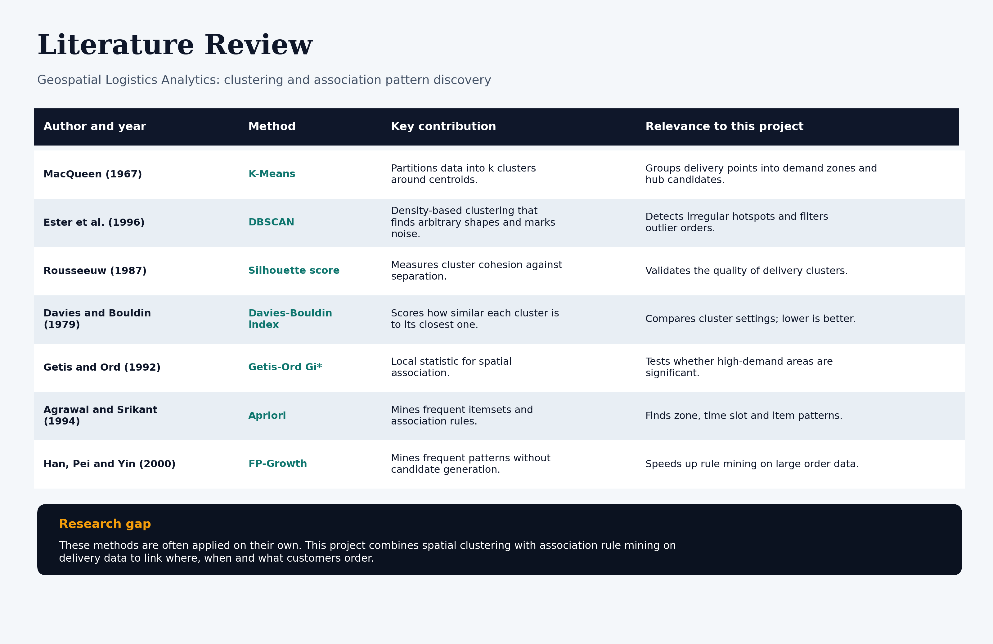
Literature Review

Slide 7
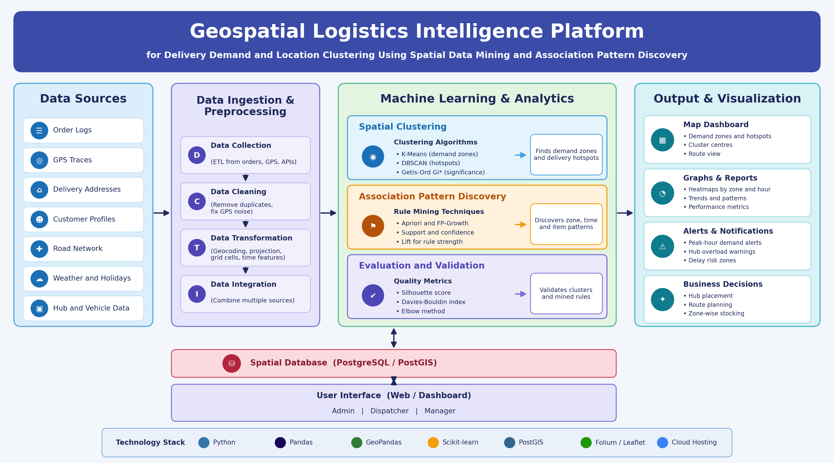
System Architecture

Slide 8
MODULE 1
Data Collection & Data Warehouse
Collects delivery order logs (order ID, timestamp, item category, quantity) and GPS traces (latitude, longitude, speed, time).
Adds delivery address data (pincode, locality, geocoded points) and context data such as road network, weather, holidays and hub or vehicle details.
Loads all sources through ETL pipelines in batch mode, with streaming as a future option.
Cleans the data by removing duplicates, out-of-range coordinates and GPS noise, and by fixing or dropping missing timestamps.
Transforms the data by geocoding addresses, converting coordinates to a metric projection, assigning grid cells and deriving hour, weekday and peak-season features.
Stores the cleaned data in a central spatial data warehouse (PostgreSQL / PostGIS) using a star schema, with a delivery fact table linked to location, time, customer and item dimensions.

Slide 9
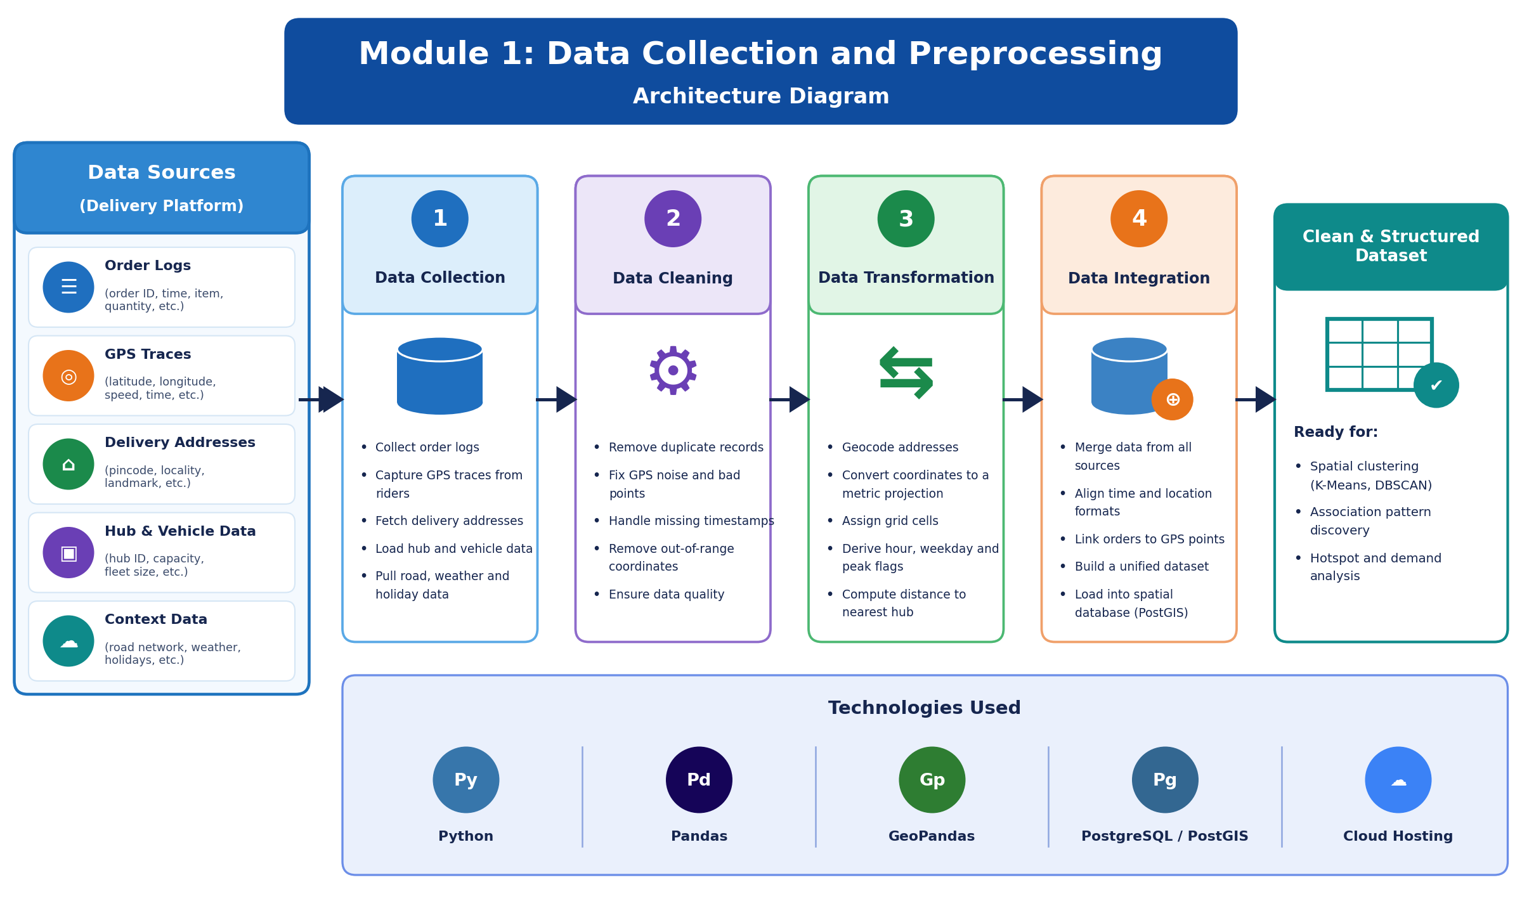
ARCHITECTURE DIAGRAM

Slide 10
MODULE 2
Customer Churn Prediction
Data Analysis: Analyze customer purchase history, order frequency, spending patterns, and activity to understand customer behaviour.
Feature Selection: Select important customer details, such as purchase frequency, time since last purchase, and total spending, for prediction.
Classification Algorithms: Apply machine learning algorithms such as Logistic Regression, Decision Tree, and Random Forest to predict customer churn.
Churn Prediction Results: Classify customers as likely to churn or likely to continue purchasing, helping businesses take steps to improve customer retention.

Slide 11
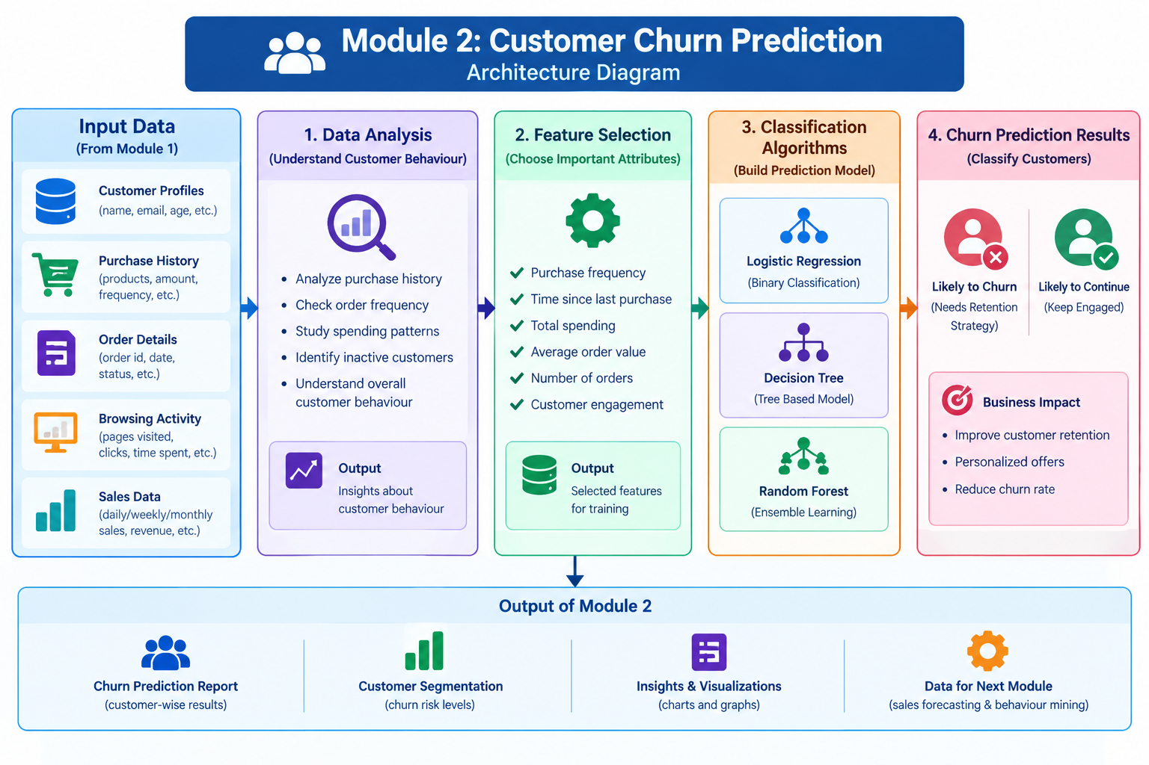
ARCHITECTURE DIAGRAM

Slide 12
MODULE 3
Sales Prediction and Forecasting
Sales Data Analysis: Analyze historical sales records, product details, order quantities, revenue, and purchasing trends.
Feature Selection: Select important factors such as previous sales, product demand, order frequency, and seasonal trends for prediction.
Sales Prediction: Apply machine learning algorithms such as Linear Regression, Random Forest, and LSTM to estimate future sales.
Sales Forecasting Results: Generate predicted sales reports and graphs to help businesses plan inventory, understand demand, and make better business decisions.

Slide 13
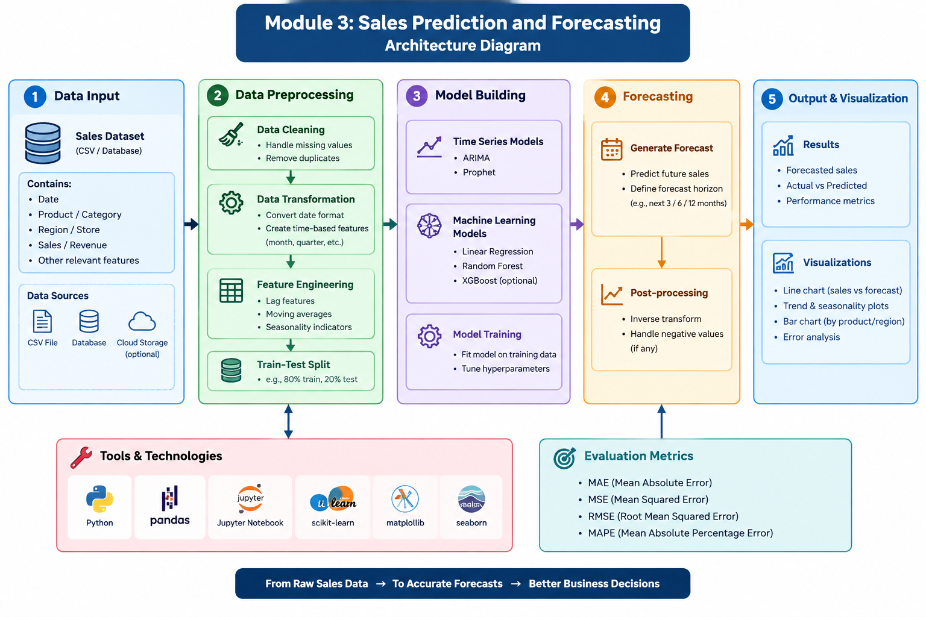
ARCHITECTURE DIAGRAM

Slide 14
MODULE 4
Customer Behaviour Mining and Intelligence Dashboard
Customer Behaviour Analysis – Analyze customer purchase history, browsing activity, and spending patterns to understand customer preferences.
Customer Segmentation – Group customers based on purchasing behaviour, spending habits, and purchase frequency.
Intelligence Dashboard – Display customer churn predictions, sales forecasts, and customer behaviour insights using interactive charts.
Business Insights and Recommendations – Generate data-driven reports to improve customer retention, optimize sales, and support business decisions.

Slide 15
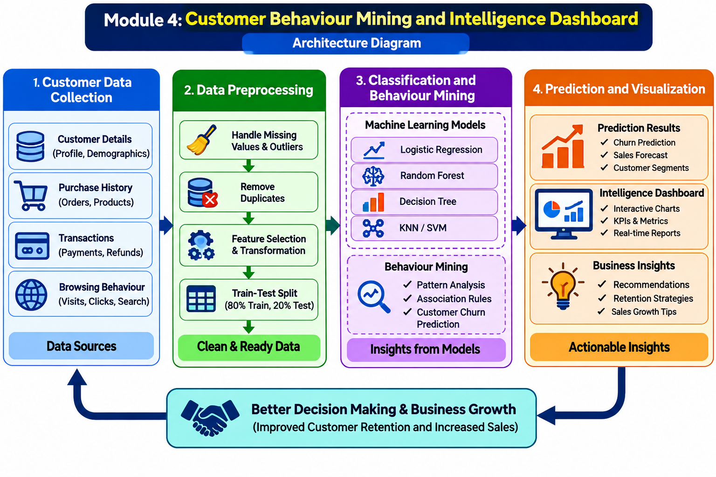
ARCHITECTURE DIAGRAM

Slide 16
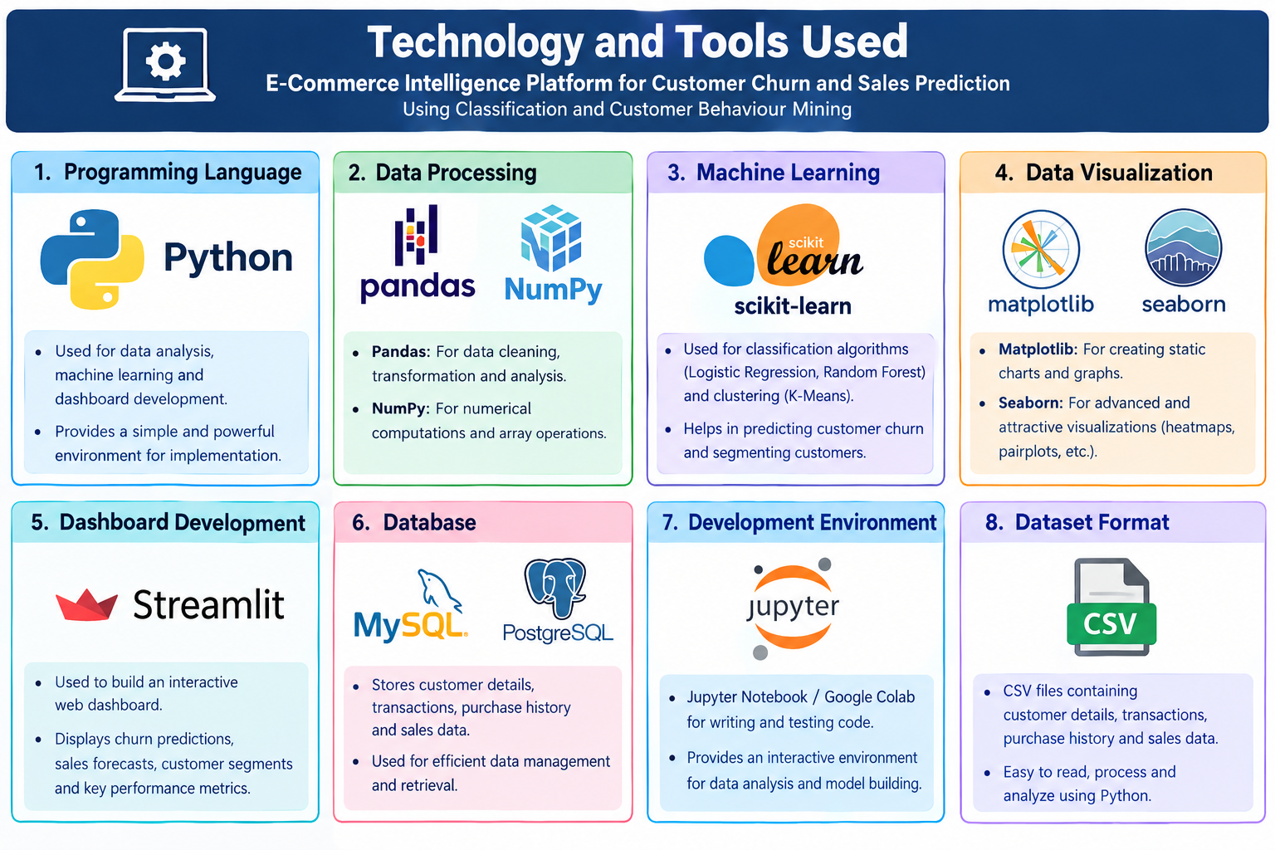
Technology and Tools Used

Slide 17

Challenges & Limitations
Data Quality Issues – Missing, duplicate, or inaccurate customer data may reduce prediction accuracy.
Model Accuracy – Machine learning models may not always predict customer churn and sales correctly.
Data Privacy and Security – Protecting sensitive customer information is essential.
Scalability and Performance – Processing large volumes of e-commerce data may require additional computing resources.

Slide 18
CONCLUSION
Customer Churn Prediction: Identifies customers who are likely to stop purchasing using machine learning algorithms.
Sales Forecasting: Predicts future sales trends to support better business planning.
Customer Behaviour Analysis: Analyzes purchasing patterns and groups customers based on their behaviour.
Business Intelligence: Provides an interactive dashboard to improve customer retention, increase sales, and support data-driven decisions.

Slide 19
REFERENCE
Tang, H. Y., & Ya’acob, S. (2023). E-Commerce Customer Churn Prediction for the Marketplace in Malaysia. Open International Journal of Informatics. https://doi.org/10.11113/oiji2023.11n2.273
Performance Evaluation of Various Classification Techniques for Customer Churn Prediction in E-commerce. (2022). Microprocessors and Microsystems, 94, 104680. https://doi.org/10.1016/j.micpro.2022.104680
E-commerce Customer Churn Prevention Using Machine Learning-Based Business Intelligence Strategy. (2023). Measurement: Sensors, 27, 100728. https://doi.org/10.1016/j.measen.2023.100728
Scikit-learn Developers. Scikit-learn User Guide: Classification and Clustering. https://scikit-learn.org/stable/user_guide.html
Streamlit Developers. Streamlit Documentation: Data Visualization and Interactive Dashboards.https://docs.streamlit.io/

Slide 20
Thank You

